Slide 1
8 Golden rules, 2 universities
Luis Guillén Servera, Jorge Lang-Lenton Ferreiro

Slide 2



Slide 3

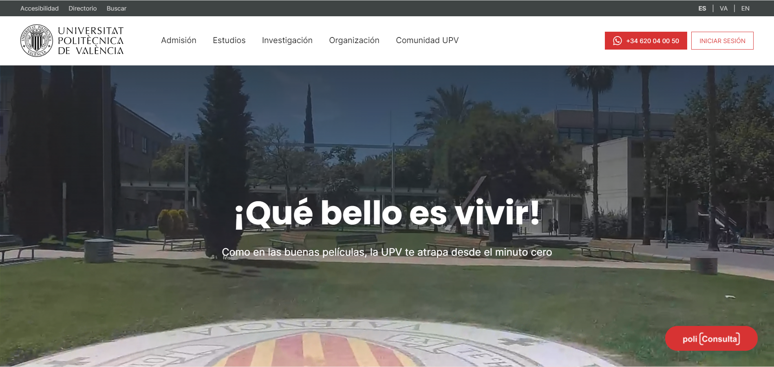
Accessibility
UFV
UPV
Good images, color, layout and font distribution.
Intuitive design on the banners, sections expected from a college’s page.

Slide 4
Usability
UFV
UPV
Intuitive for novice, experts, different age ranges.
It can change to English, but cannot adapt to disabilities.
Intuitive design on the banners, sections expected from a college’s page.

Slide 5
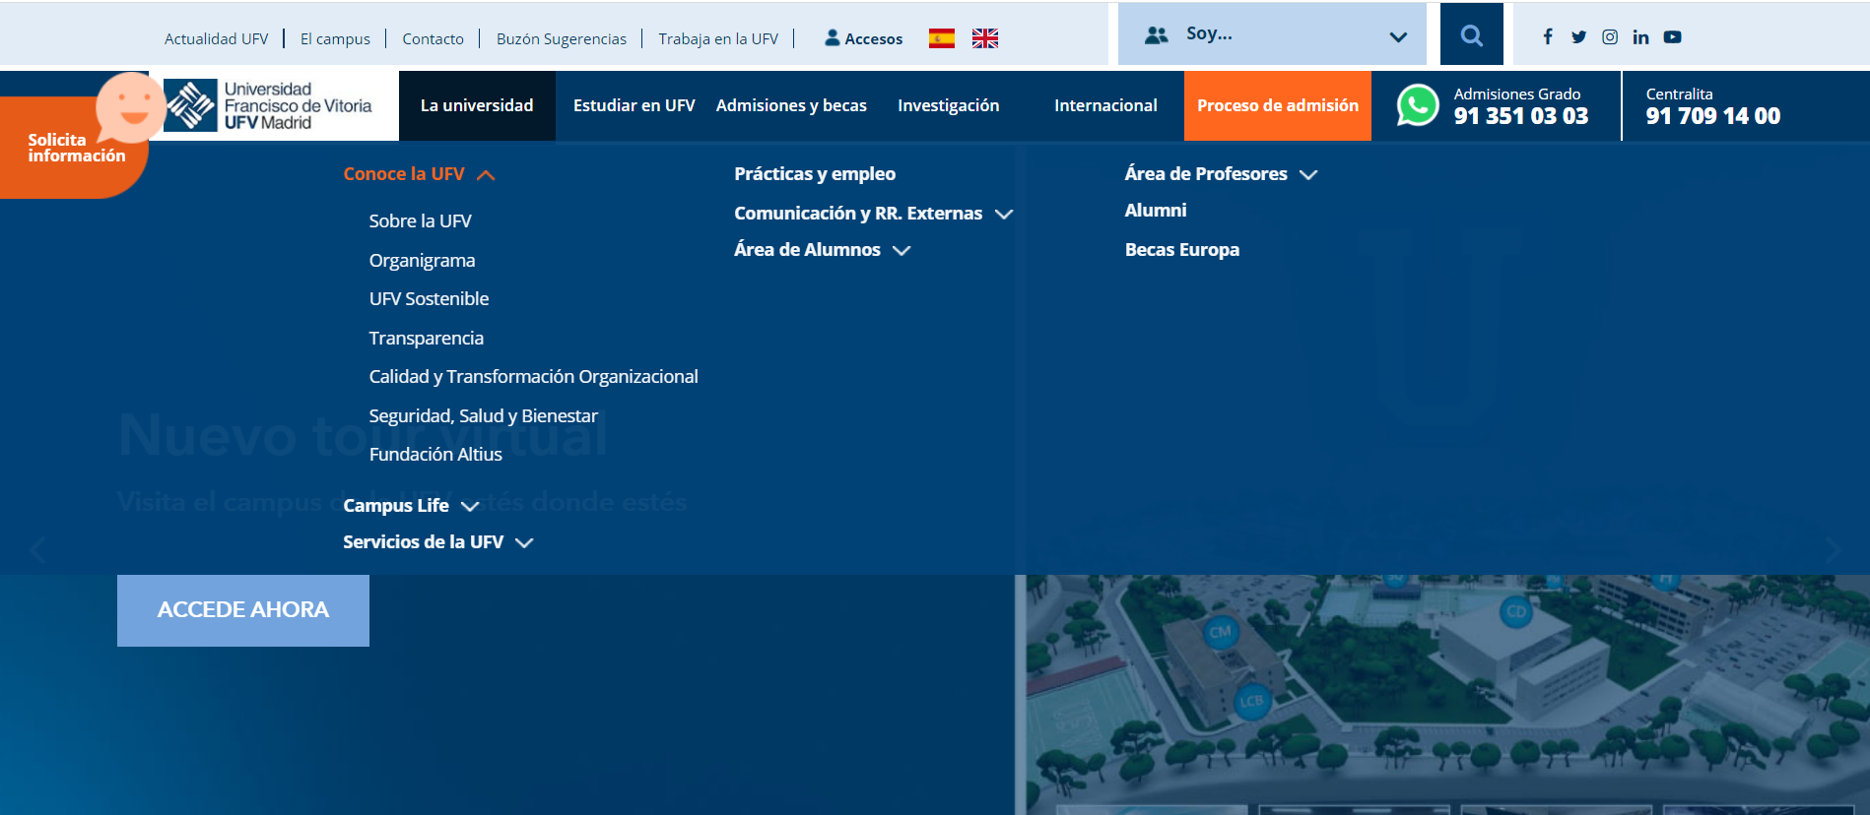
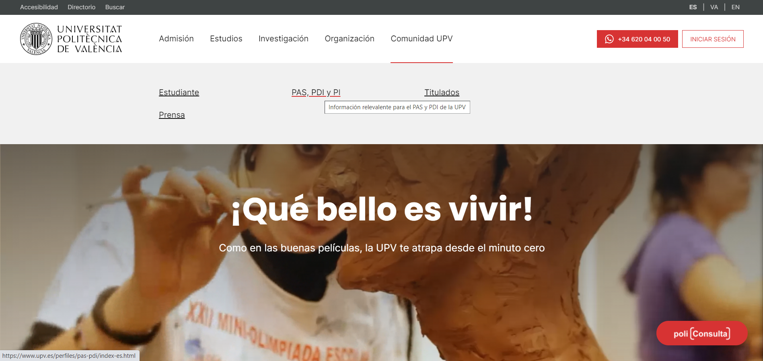
Feedback
UFV
UPV
Information deployed
Changing button’s colors, underlining words when pointing
+

Slide 6
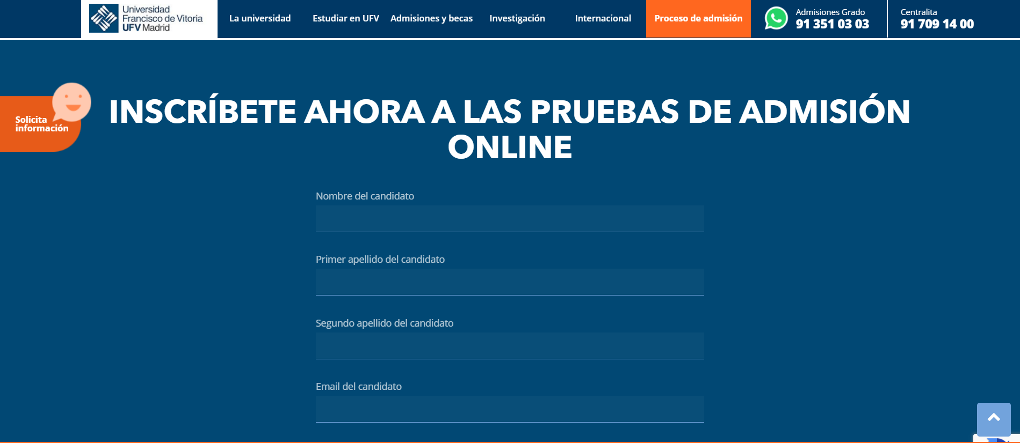
Steps
UFV
UPV
Registration in one single step
What’s basic for submiting a message or application.

Slide 7
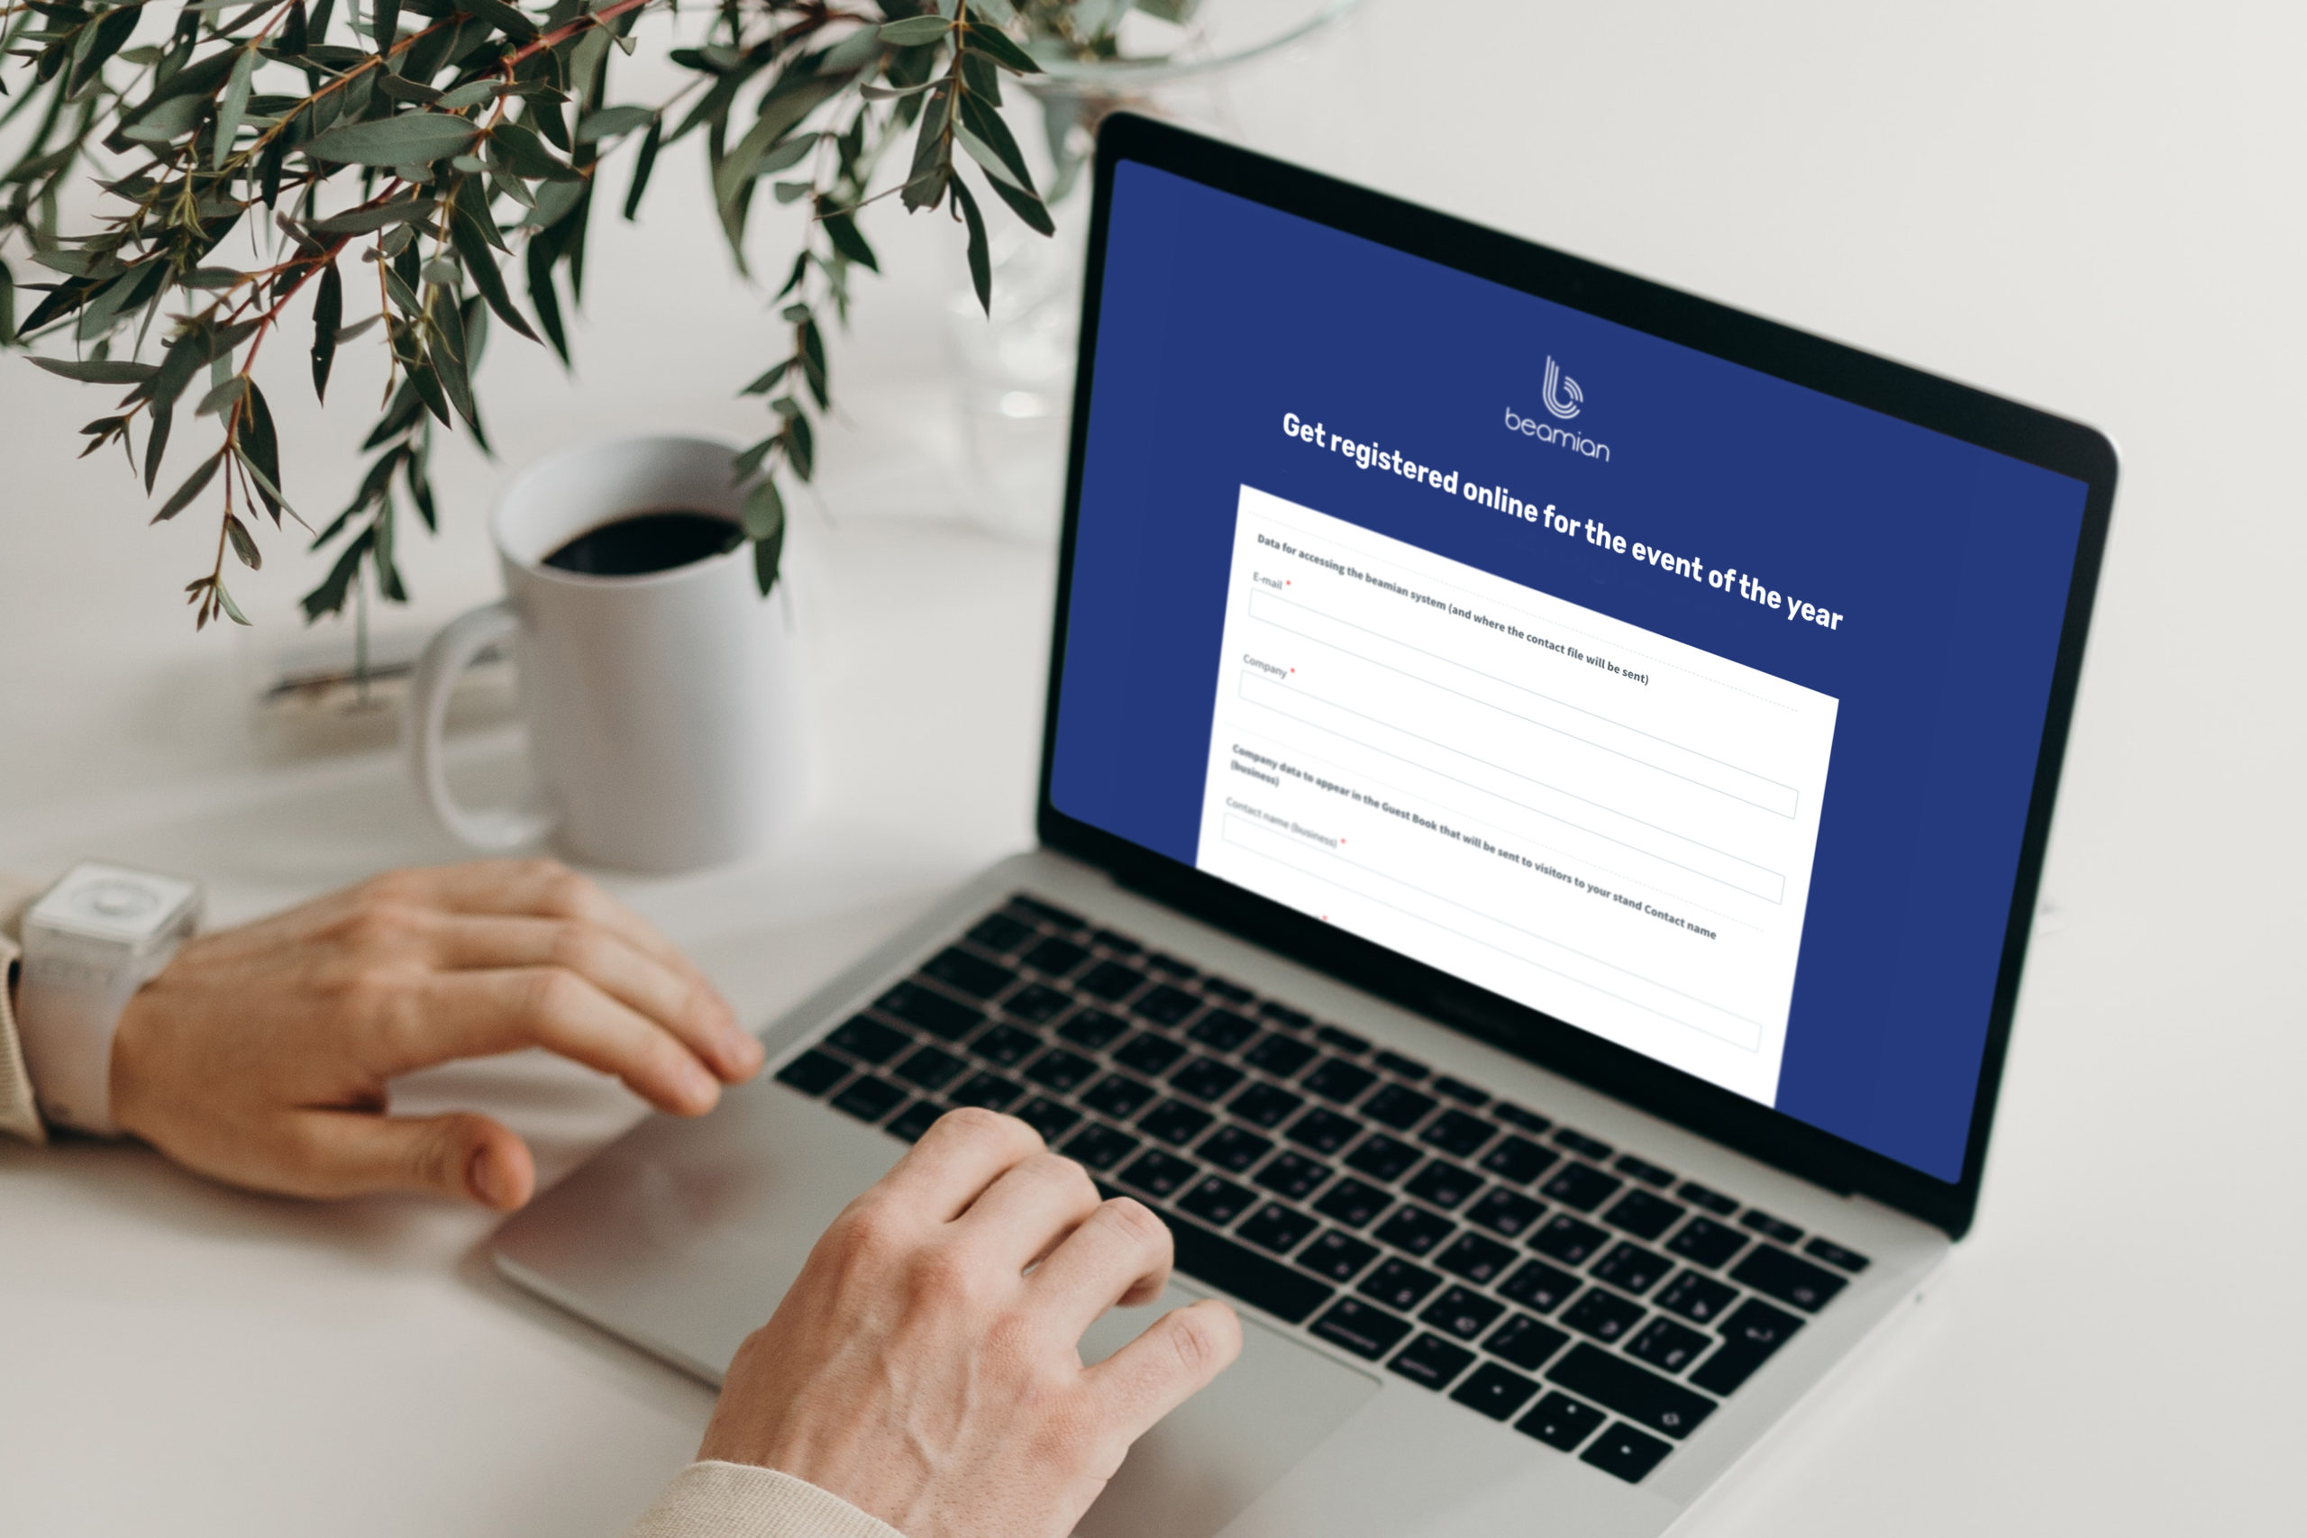
Prevent errors
UFV
UPV
It won’t tell you the errors until you submit your registration.
Preferable while filling the gaps.
It has what is needed.

Slide 8
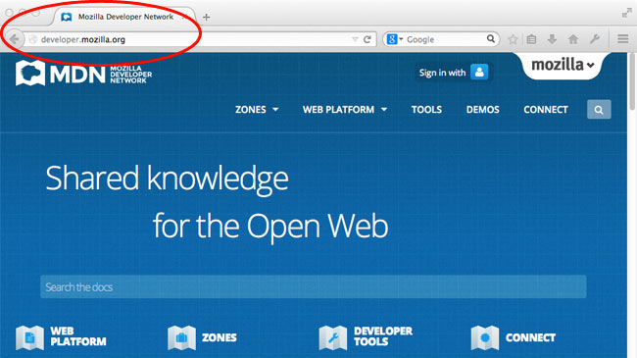
Easy reversal
UFV
UPV
You can only go back by using the browser, no possibility to go back with a specific button.

Slide 9

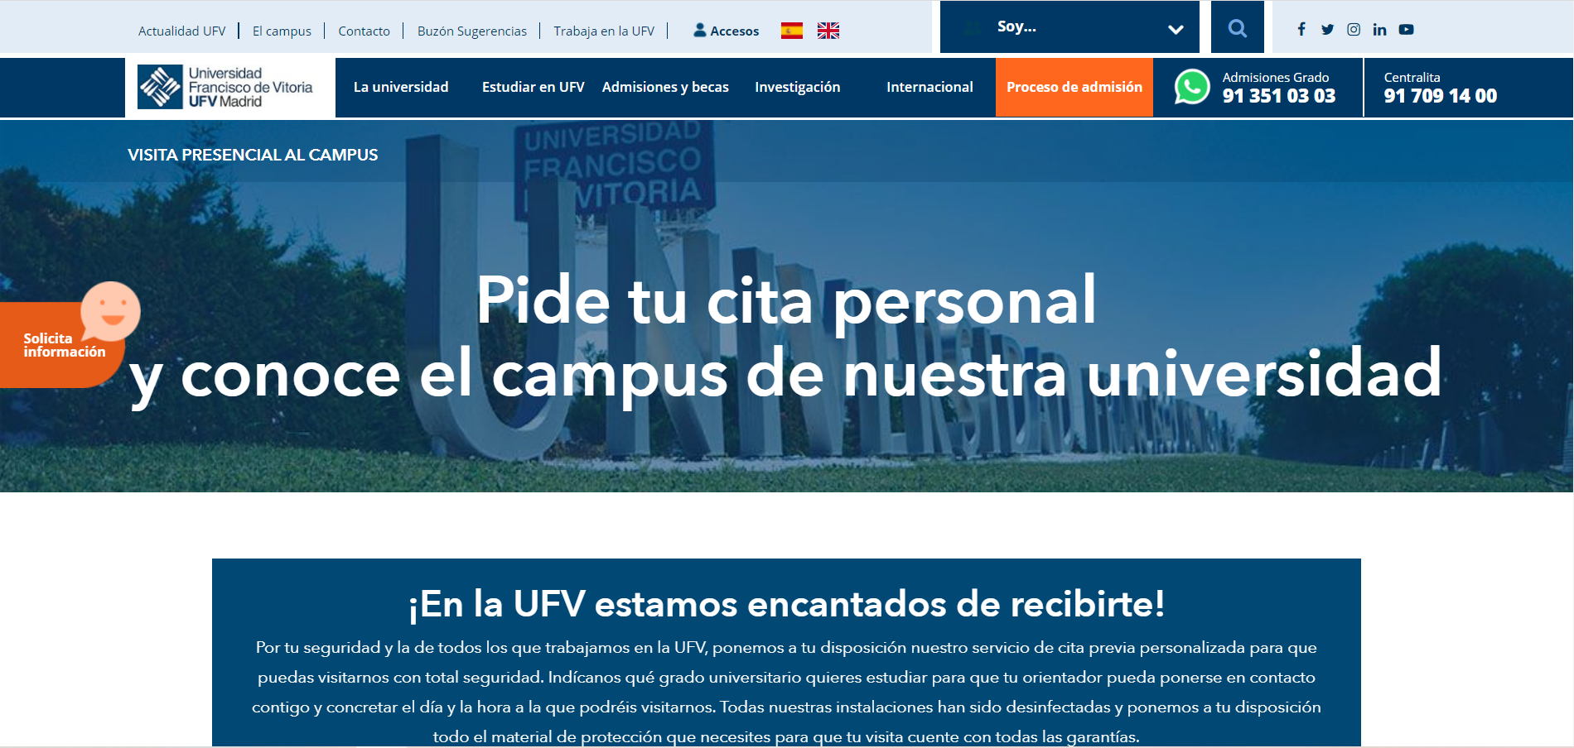
Control
UFV
UPV
Intuitive and common behaviour between sites (the sites and functionalities look similar between them, in terms of style)
Loud videos, cannot see the stop button.

Slide 10





Memory load
UFV
UPV
Remember name, surnames, postal code.
No information saving, for safety reasons.

Slide 11
